Slide 1
Η νέα εποχή στην αντιαιμοπεταλιακή θεραπεία των ασθενών με ΟΣΣ
Δρ Στασίνος Θεοδώρου
MB ChB, MRCP(UK)
Επεμβατικός Καρδιολόγος
Γενικό Νοσοκομείο Λεμεσού

Slide 2
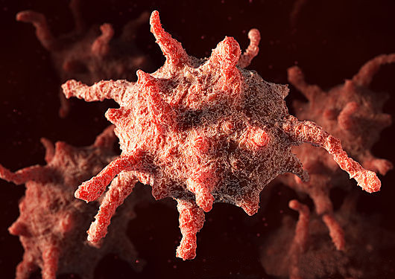

Slide 4
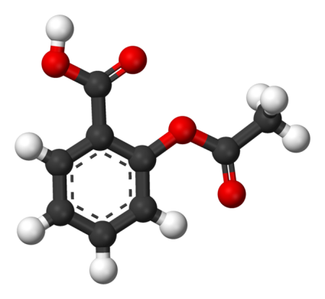
Aspirin (Acetylsalicylic Acid)
1853: Produced by chemist Charles Frederick Gerhardt
1899: “Aspirin” manufactured and marketed by Bayer
Initially used as anti-inflammatory
Widespread use in flu pandemics
1960s: Discovery of anti-platelet properties
First trials in the 1970 showed benefit in secondary prevention in MI survivors
By the 1980 ASA was widely used for the prevention of cardiovascular disease

Slide 5
Mode of anti-platelet action
Inhibition of Cyclooxygenase (COX)
Decreased production of Thromboxane
Lowers platelet aggregation
Prevention of thrombus formation
Protection against thrombotic cardiovascular disease.

Slide 6
Recent Evidence Secondary Prevention
Collaborative meta-analysis of randomised trials of antiplatelet therapy for prevention of death, myocardial infarction, and stroke in high risk patients.Antithrombotic Trialists' CollaborationBMJ. 2002;324(7329):71
287 studies involving 135 000 patients
MAIN OUTCOME MEASURE: "Serious vascular event": non-fatal myocardial infarction, non-fatal stroke, or vascular death
CONCLUSIONS: Aspirin is protective in most types of patient at increased risk of occlusive vascular events
Low-dose aspirin in patients with stable cardiovascular disease: a meta-analysis.Berger JS, Brown DL, Becker RCAm J Med. 2008;121(1):43
to evaluate the benefit and risk of low-dose aspirin (50-325 mg/d) in patients with stable cardiovascular disease
6 RCT’s from 1966 to 2006 (9853 patients with prior MI, angina or CVA)
CONCLUSION: In patients with stable cardiovascular disease, low-dose aspirin therapy reduces the incidence of adverse cardiovascular events and all-cause mortality, and increases the risk of severe bleeding

Slide 7
Primary prevention 1 Total of 9 Trials
Physician’s Health Study – The United States Physician's Health Study (PHS): the first to demonstrate that aspirin reduces the risk of a first MI .
British Doctor’s Trial – In the British Doctor's Trial (BDT), aspirin was given at a dose of 500 mg daily
Thrombosis Prevention Trial - The relative benefit of low-dose (75 mg) aspirin and warfarin therapy (international normalized ratio goal of 1.5) in patients at high risk was addressed in the Thrombosis Prevention Trial (TPT) .
Hypertension Optimal Treatment Trial – In the Hypertension Optimal Treatment (HOT) Trial aspirin was given at a dose of 75 mg daily.
Primary Prevention Project – In the Primary Prevention Project (PPP), enteric-coated aspirin was given at a dose of 100 mg daily.
Women’s Health Study – In the Women's Health Study (WHS), aspirin was given at a dose of 100 mg on alternate days for a mean of 10.1 years.
Aspirin for Asymptomatic Atherosclerosis trial – In the Aspirin for Asymptomatic Atherosclerosis trial (AAAT), aspirin was given at a dose of 100 mg daily .
JPAD trial – In the Japanese Primary Prevention of Atherosclerosis With Aspirin for Diabetes (JPAD) trial, aspirin was given at a dose of 81 to 100 mg daily to patients with diabetes.
POPADAD trial – In the Prevention of Progression of Arterial Disease and Diabetes (POPADAD) trial, aspirin was given at a dose of 100 mg daily to patients with diabetes.

Slide 8
Primary prevention 2
Aspirin in the primary and secondary prevention of vascular disease: collaborative meta-analysis of individual participant data from randomised trials. Antithrombotic Trialists' (ATT) Collaboration, Baigent C et al. Lancet 2009;373(9678):1849.
six primary prevention trials (95,000 individuals at low average risk)
Significant reduction in MI, CVA, death from CV cause.
Significant increase in major GI bleeds.
INTERPRETATION: In primary prevention, aspirin is of uncertain net value as the reduction in occlusive events needs to be weighed against any increase in major bleeds
Low-dose aspirin for primary prevention of atherosclerotic events in patients with type 2 diabetes: a randomized controlled trial. Ogawa H et al, Japanese Primary Prevention of Atherosclerosis With Aspirin for Diabetes (JPAD) Trial Investigators. JAMA. 2008;300(18):2134.
2539 patients with type 2 diabetes without a history of atherosclerotic disease
Primary endpoints: Atherosclerotic events
Secondary endpoints: above and combinations of primary end points plus death from any cause
CONCLUSION: In patients with type 2 diabetes, low-dose aspirin as primary prevention did not reduce the risk of cardiovascular events

Slide 9
Primary prevention 3
Aspirin for prevention of cardiovascular events in a general population screened for a low ankle brachial index: a randomized controlled trial. Fowkes FG, et al. Aspirin for Asymptomatic Atherosclerosis Trialists. JAMA. 2010;303(9):841.
To determine the effectiveness of aspirin in preventing events in people with a low ABI identified on screening the general population
28980 patients without clinical CV disease were screened for ABI
3350 with low ABI (≤ 0.95) included
CONCLUSION: The administration of aspirin compared with placebo did not result in a significant reduction in vascular events.
The prevention of progression of arterial disease and diabetes (POPADAD) trial: factorial randomised placebo controlled trial of aspirin and antioxidants in patients with diabetes and asymptomatic peripheral arterial disease.Belch J, et al. Prevention of Progression of Arterial Disease and Diabetes Study Group, Diabetes Registry Group, Royal College of Physicians Edinburgh. BMJ. 2008;337:a1840
CONCLUSION: No evidence to support the use of aspirin or antioxidants in primary prevention of cardiovascular events and mortality in the population with diabetes studied

Slide 10
Primary prevention 4
Effect of aspirin on mortality in the primary prevention of cardiovascular disease. Raju N et al. Am J Med. 2011;124(7):621.
An updated meta-analysis of randomized controlled trials of aspirin to obtain best estimates of the effect of aspirin on mortality in primary prevention
Nine randomized controlled trials enrolling 100,076 participants
CONCLUSION: Aspirin prevents deaths, myocardial infarction, and ischemic stroke, and increases hemorrhagic stroke and major bleeding when used in the primary prevention of cardiovascular disease
Meta-analysis of multiple primary prevention trials of cardiovascular events using aspirin. Bartolucci AA, Tendera M, Howard G. Am J Cardiol. 2011;107(12):1796
Nine randomized trials. Combined sample consists of about 90,000 subjects
Primary prevention with aspirin decreased the risk for total CV events and nonfatal MI, but there were no significant differences in the incidences of stroke, CV mortality, all-cause mortality and total coronary heart disease.
Effect of aspirin on vascular and nonvascular outcomes: meta-analysis of randomized controlled trials. Seshasai SR et al. Arch Intern Med. 2012;172(3):209.
CONCLUSIONS: Important reductions in nonfatal MI. No reductions in either cardiovascular death or cancer mortality.
Because the benefits are further offset by clinically important bleeding events, routine use of aspirin for primary prevention is not warranted and treatment decisions need to be considered on a case-by-case basis

Slide 11
Aspirin for everybody? What is the risk / benefit ratio?
More MI
?More CVA
No Aspirin
Less MI
Aspirin
?Less CVA
?Less CV deaths
More bleeding
?More CV death
Less bleeding

Slide 12
Risk / benefit estimation
In secondary prevention:
Benefit of therapy >> absolute risk
20% risk reduction Vs 1% - 4% risk (depending on age)
Standard therapy established
In primary prevention:
Average Risk reduction about 5%
The benefits outweigh the risks only when the risk of a cardiovascular event begins to exceed 6 to 10 percent in ten years
Targeted treatment on an individual-based risk assessment.
CV risk Vs bleeding risk (Age, previous history etc)
Several suggested calculator systems exist

Slide 14
ADP antagonists(Thienopyridines and Nucleosite analogs)
Adenosine Diphosphate stored in platelet dense granules.
Released upon platelet activation
ADP stimulates P2Y12 and P2Y1 receptors
Resulting in thromboxane A2 formation, protein phosphorylation and increased cytosolic Ca++.
ADP antagonists inhibit the P2Y12 platelet receptor
INHIBITION OF PLATELET AGGREGATION

Slide 15
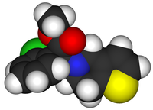
Clopidogrel
Specific and irreversible P2Y12 inhibition
Blocking activation of GPIIb/IIIa pathway
Clopidogrel is a pro-drug
Hepatic activation by cytochrome P450 enzymes
Requires two stages of CYP dependent oxidation to reach the active form of the drug

Slide 16
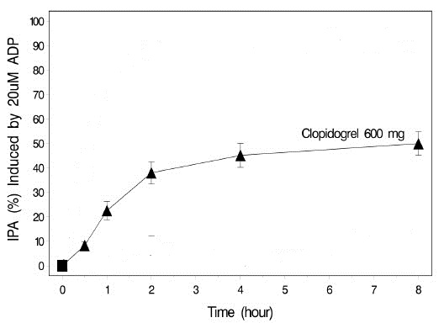
Clopidogrel Pharmacokinetics
Inhibition of platelet aggregation is dose dependent
300-600mg loading: onset detected within 2 hours
Metabolism: Hepatic via esterase-mediated hydrolysis to a carboxylic acid derivative (inactive) and via CYP450-mediated (CYP2C19 primarily) oxidation to a thiol metabolite (active)

Slide 17
Clopidogrel-Evidence 1
"A Randomized, Blinded, Trial of Clopidogrel Versus Aspirin in Patients at Risk of Ischaemic Events (CAPRIE). CAPRIE Steering Committee," Lancet, 1996, 348(9083):1329-39
randomised, blinded, international trial
19,185 patients, with more than 6300 in each of the clinical subgroups
Recent ischaemic stroke, recent myocardial infarction, or peripheral arterial disease.
Clopidogrel 75mg Vs Aspirin 325mg
INTERPRETATION: Long-term administration of Clopidogrel to patients with atherosclerotic vascular disease is more effective than aspirin in reducing the combined risk of ischaemic stroke, myocardial infarction, or vascular death.
“The Clopidogrel in Unstable angina to prevent Recurrent Events (CURE) trial”. N Engl J Med. 2001;345(7):494.
12,562 patients who had presented within 24 hours after the onset of symptoms
Clopidogrel or placebo in addition to aspirin for 3 to 12 months.
CONCLUSIONS: The antiplatelet agent clopidogrel has beneficial effects in patients with acute coronary syndromes without ST-segment elevation. However, the risk of major bleeding is increased among patients treated with clopidogrel.
IMPORTANCE OF DUAL ANTIPLATELT THERAPY

Slide 18
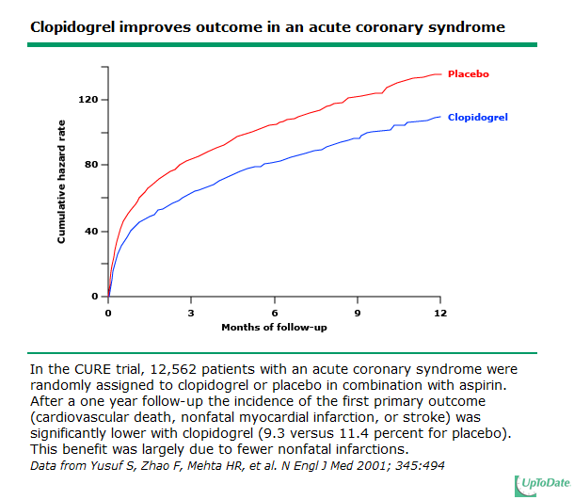

Slide 19
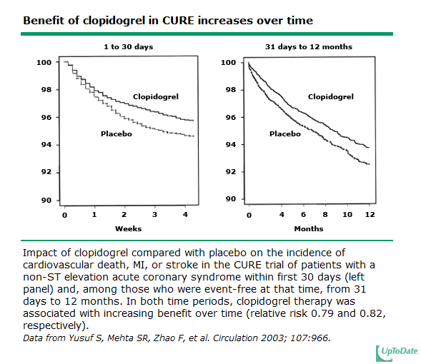

Slide 20
Clopidogrel Evidence 2
Effects of pretreatment with clopidogrel and aspirin followed by long-term therapy in patients undergoing percutaneous coronary intervention: the PCI-CURE study. Lancet. 2001;358(9281):527
4.5% patients in the clopidogrel group had the primary endpoint, compared with 6.4% in the placebo group (relative risk 0.70 [95% CI 0.50-0.97], p=0.03).
Early and sustained dual oral antiplatelet therapy following percutaneous coronary intervention: a randomized controlled trial. CREDO Investigators. JAMA. 2002;288(19):2411.
CONCLUSIONS: Following PCI, long-term (1-year) clopidogrel therapy significantly reduced the risk of adverse ischemic events.

Slide 21
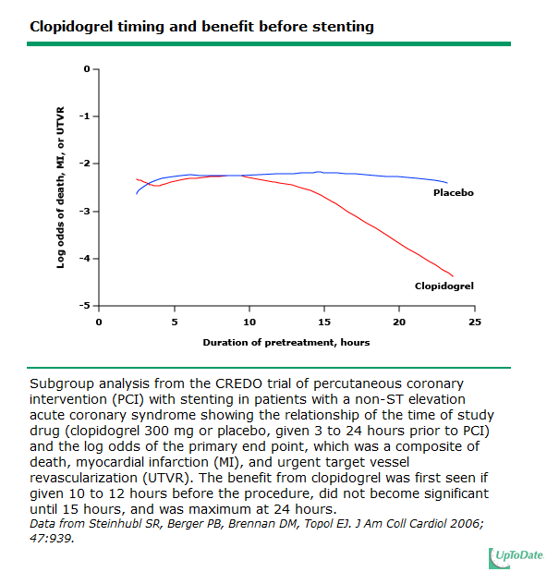

Slide 22
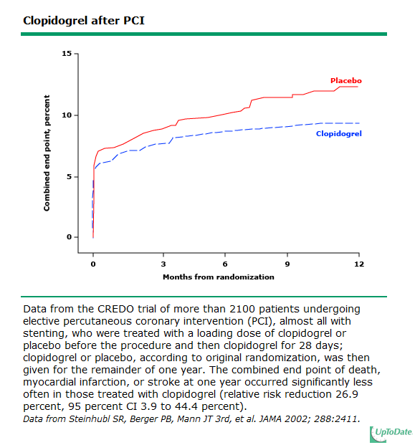

Slide 23
Clopidogrel Evidence 3 Timing with PCI
Time dependence of platelet inhibition after a 600-mg loading dose of clopidogrel in a large, unselected cohort of candidates for percutaneous coronary intervention. Circulation. 2005;111(20):2560.
CONCLUSIONS: After loading with 600 mg of clopidogrel, the full antiplatelet effect of the drug is achieved after 2 hours.
Influence of treatment duration with a 600-mg dose of clopidogrel before percutaneous coronary revascularization. ISAR-REACT Study Investigators. J Am Coll Cardiol. 2004;44(11):2133.
600mg, four groups: 2 to 3 hours, 3 to 6 hours, 6 to 12 hours, and >12 hours.
No significant difference among the four groups in the incidence of death, MI, or urgent revascularization at 30 days

Slide 24
Clopidogrel evidence 4 Dose and outcome
ARMYDA-2. Circulation.2005;111(16):2099
Clopidogrel 300mg Vs 600mg (+Aspirin)
CONCLUSIONS: Pretreatment with a 600-mg clopidogrel 4 to 8 hours before significantly reduced periprocedural MI in patients undergoing PCI (4% Vs 12%, p:0.041)
Benefit of a 600-mg loading dose of clopidogrel on platelet reactivity and clinical outcomes in patients with non-ST-segment elevation acute coronary syndrome undergoing coronary stenting. J Am Coll Cardiol. 2006;48(7):1339.
CONCLUSIONS: In NSTE ACS patients undergoing coronary stenting, a 600-mg loading dose of clopidogrel shows its benefit on platelet reactivity and clinical prognosis
CURRENT-OASIS 7. N Engl J Med. 2010;363(10):930.
25086 ACS patients (600mg Vs 300mg Clopidogrel)
CONCLUSIONS: in the subgroup of patients who underwent PCI (n = 17,263) the higher dose of clopidogrel significantly reduced the rate of the primary outcome. (3.9% Vs 4.5%) and stent thrombosis.

Slide 25
A 600 mg loading dose produces
a greater maximal antiplatelet effect
an earlier antiplatelet effect
may diminish the likelihood of clopidogrel resistance
What about 900mg clopidogrel?
No supportive evidence:
ISAR-CHOICE Circulation. 2005;112(19):2946
ALBION Trial Investigators. J Am Coll Cardiol. 2006;48(5):931.

Slide 26
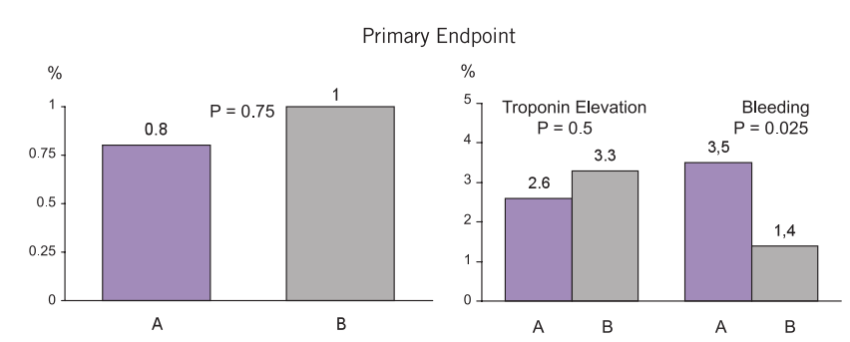
Clopidogrel in elective PCI (Non-ACS patients)
PRAGUE-8 Trial. WidimiskyEHJ 2008;29:1945-1503
Clopidogrel 600mg at least 6hours before PCI Vs minutes before.
End points: death/MI/Stroke re-intervention in 7 days
Conclusion: Clopidogrel can be given safely after angiography minutes before PCI

Slide 27
Clopidogrel Resistance
“Resistance”? Or “Non-response”? Or“Treatment failure”?
Multiple reasons for “treatment failure”
Treatment failure: Clinical observation
Resistance: incomplete blockade of the platelet membrane P2Y12 receptor
Drug absorption
Metabolism
Drug-drug interaction

Slide 28
Clopidogrel resistance 2
Light transmission aggregometry with ADP
Whole blood aggregometry with ADP, PFA-100 using the collagen-ADP cartridge
VerifyNow P2Y12
Poor correlation between them

Slide 29
Clopidogrel Resistance 3
Variable platelet response
Genetic variability
Polymorphisms in enzymes CYP 1A2, CYP3A4, CYP2C19, PON1
Polymorphism within the platelet P2Y12 receptor
Polymorphism in enzymes affecting drug transport
Clopidogrel Prodrug
Oxidation by CY P2C19 isoenzymes
Intermediate metabolite
Paraoxonase enzymes
Active metabolite
P2Y12 receptor binding

Slide 30
Clopidogrel Resistance 4
Adverse in vitro and in vivo effects of reduced function CYP2C19 alleles have been demonstrated
EXCELSIOR study: loss-of-function CYP2C19 correlated with higher residual platelet aggregation (RPA) and increased one-year incidence of death and myocardial infarction
TRITON-TIMI 38: carriers of a reduced-function CYP2C19 allele had a significant increase in the composite primary efficacy outcome of the risk of death from cardiovascular causes, myocardial infarction, or stroke as well as a significant increase in the risk of stent thrombosis
J Am Coll Cardiol. 2005;45(9):1392: A 600-mg clopidogrel loading dose reduces the incidence of NR as compared to a 300-mg dose

Slide 31
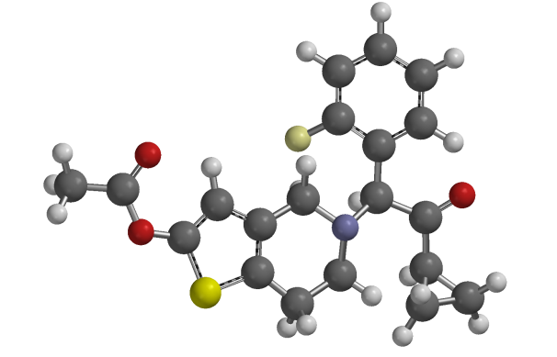
Prasugrel
Similar pharmacological action to clopidogrel
Irriversible P2Y12 receptor blockade
Also a pro-drug but requires only one stage of metabolism
Rapidly metabolised to the active metabolide
No need of oxidation be CYP2C19
More rapid action
Higher degree of platelet activation

Slide 32
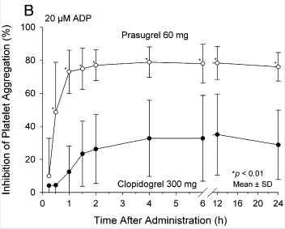
Prasugrel Pharmacokinetics
60mg loading: onset of action 30 minutes
Half-life elimination: ~7 hours (range 2-15 hours)
Metabolism: Rapid intestinal and serum metabolism via esterase-mediated hydrolysis to a thiolactone (inactive), which is then converted, via CYP450-mediated (primarily CYP3A4 and CYP2B6) oxidation, to an active metabolite

Slide 33
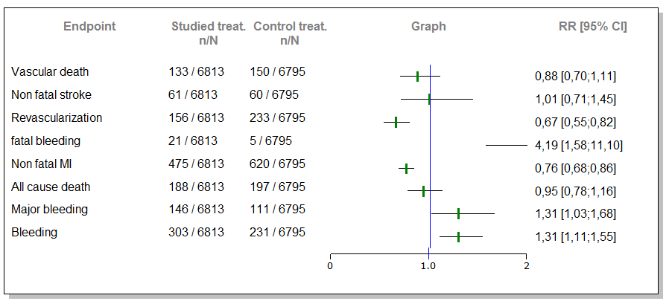
Prasugrel Evidence 1
TRITON-TIMI 38 :N Engl J Med. 2007;357(20):2001
13608 ACS patients scheduled for PCI
60mg prasugrel Vs 300mg clopidogrel
Aspirin as standard in both arms
CONCLUSIONS: Prasugrel therapy was associated with significantly reduced rates of ischemic events, including stent thrombosis, but with an increased risk of major bleeding, including fatal bleeding. Overall mortality did not differ significantly between treatment groups

Slide 34
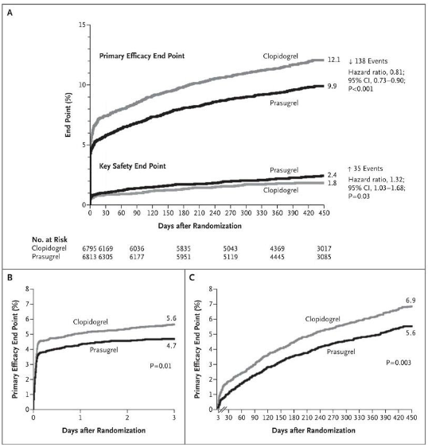

Slide 35
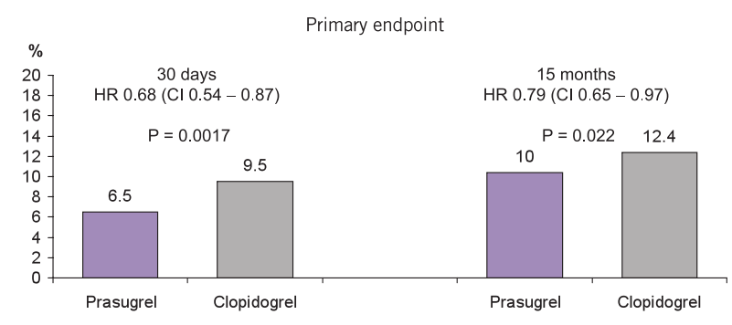
Prasugrel Evidence 2 STEMI / PPCI
Prasugrel compared with clopidogrel in patients undergoing percutaneous coronary intervention for ST-elevation myocardial infarction (TRITON-TIMI 38): double-blind, randomised controlled trial. Montalescot Lancet 2009;373:723-31
3534 patients with STEMI undergoing PPCI
Prasugrel 60mg / 10mg Vs Clopidogrel 300mg / 75mg

Slide 36
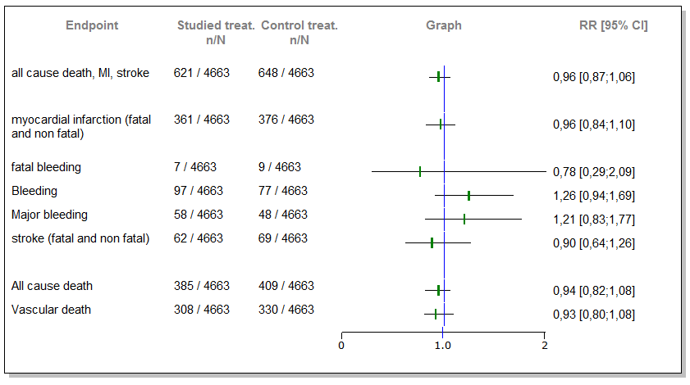
Prasugrel Evidence 3
TRILOGY ACS :N Engl J Med. 2012;367(14):1297.
9326 ACS patients not for PCI
Prasugrel 30mg /10mg daily Vs Clopidogrel 300mg/75mg daily
CONCLUSIONS: Prasugrel did not significantly reduce the frequency of the primary end point, as compared with clopidogrel, and similar risks of bleeding were observed

Slide 37
Prasugrel Evidence 4 Ongoing Trials...
TRIGGER-PCI
patients With High Platelet Reactivity on Clopidogrel Following Elective Percutaneous Coronary Intervention With Implantation of Drug-Eluting Stent
Prasugrel Vs Clopidogrel
BRAVE-4
STEMI patients undergoing PPCI
Prasugrel + Bivalirudin Vs Clopidogrel + Heparin

Slide 38
Prasugrel Summary
Rapid onset compared to clopidogrel (30 minutes)
Use in PPCI specifically
Resistance not a problem
Predictors of less net clinical efficacy
>75 year olds
<60Kg
History of CVA / TIA

Slide 39
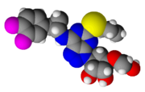
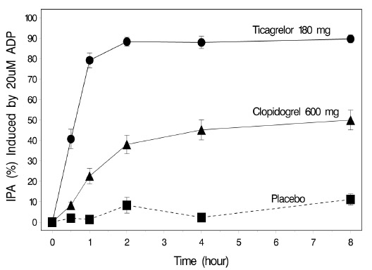
Ticagrelor
Nucleoside analoque
Reversible P2Y12 binding
Not dependent on hepatic activation
Directly binding to P2Y12 receptor
Rapid action (30 minutes)

Slide 40
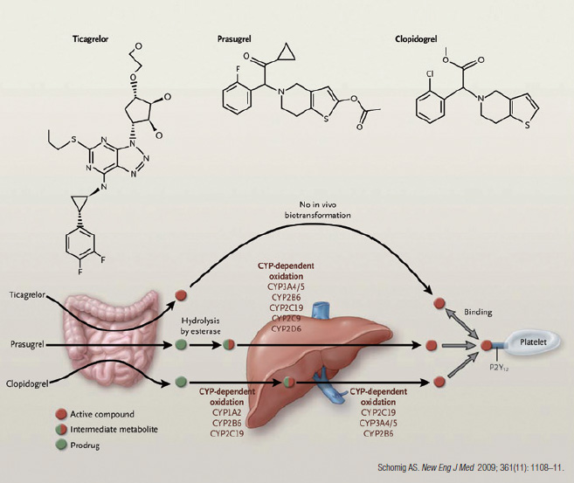

Slide 41
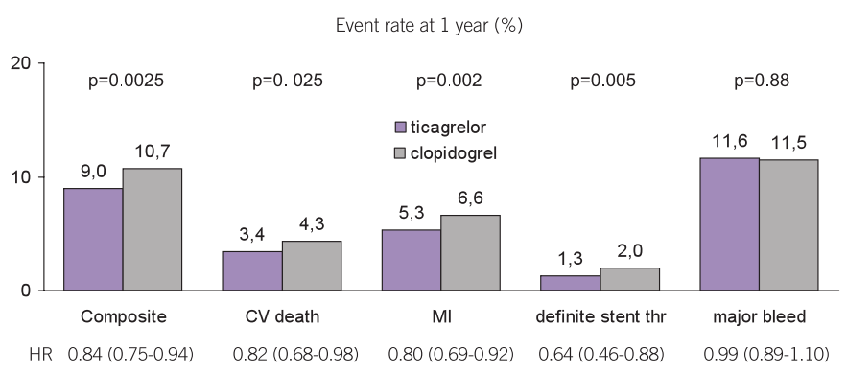
Ticagrelor Evidence
Ticagrelor versus clopidogrel in patients with acute coronary syndromes. PLATO Investigators. N Engl J Med. 2009;361(11):1045
18624 patients with ACS (13408 invasive strategy planed)
Ticagrelor 180mg / 90mg bd Vs Clopidogrel 300mg / 75mg (+Aspirin )
CONCLUSIONS: Ticagrelor as compared with clopidogrel significantly reduced the rate of cardiovascular events, without an increase in the rate of overall major bleeding.

Slide 42
ADP Antagonists Summary

Slide 43
Glycoprotein IIb/IIIa Inhibitors
Inhibition of the final pathway of platelet aggregation
Intravenous use
Abciximab is a monoclonal antibody directed against the receptor
Tirofiban and Eptifibatide are high affinity non-antibody receptor inhibitors

Slide 44
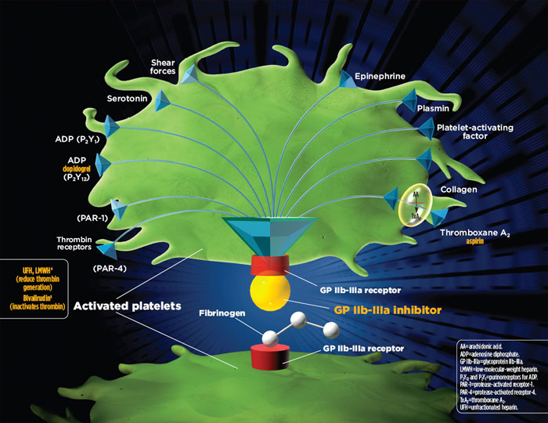

Slide 45
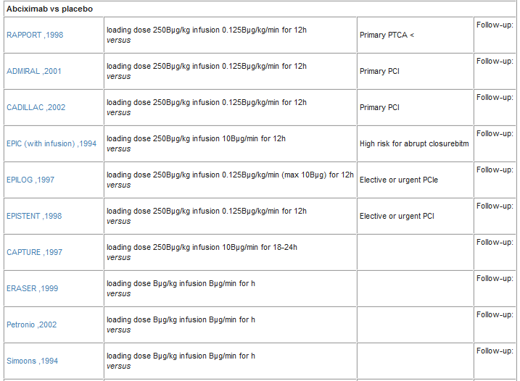
GP IIb/IIIa Evidence Abciximab in PCI

Slide 46
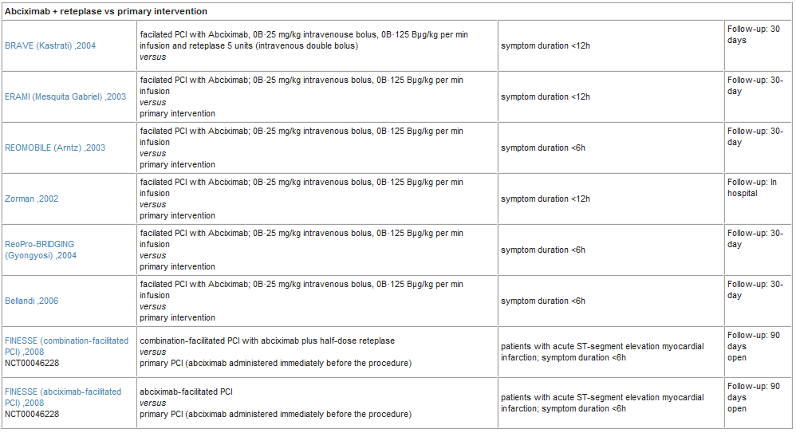
GP IIb/IIIa Evidence Abciximab in AMI

Slide 47
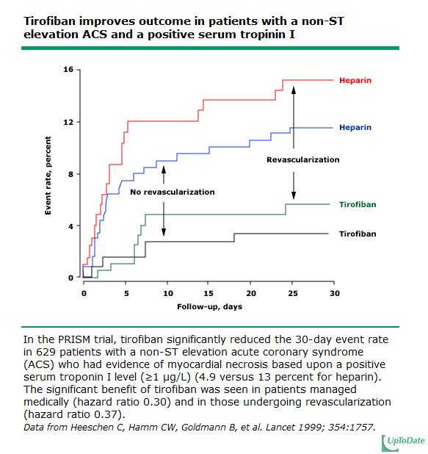
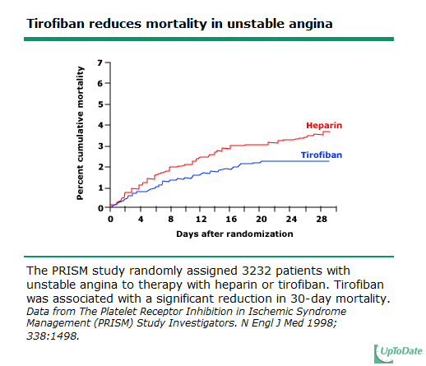
GP IIb/IIIa Evidence Tirofiban
PRISM trial: N Engl J Med. 1998;338(21):1498
3232 ACS patients (Tirofiban Vs Heparin)
PCI discouraged

Slide 48
GP IIb/IIIa Evidence Tirofiban
RESTORE :Circulation. 1997;96(5):1445
2139 ACS patients (PCI <72hours) (Tirofiban Vs Placebo)
CONCLUSIONS: The primary composite end point (death, MI, angioplasty failure requiring CABG or unplanned stenting, recurrent ischemia requiring repeat PTCA) at 30 days was reduced by tirofiban
ADVANCE trial: J Am Coll Cardiol. 2004;44(1):14
Safety of higher dose bolus Tirofiban in High risk PCI
CONCLUSIONS: The use of tirofiban, when administered at HDB, is safe and significantly reduces the incidence of ischemic/thrombotic complications during high-risk PCI

Slide 49
GP IIb/IIIa Evidence Tirofiban in STEMI
TIGER-PA: Circulation. 2003;107(11):1497
PPCI with early Tirofiban Vs primary intervention
CONCLUSIONS: early administration of tirofiban improves angiographic outcomes and is safe and feasible in patients undergoing primary angioplasty
On-TIME: Eur Heart J. 2004;25(10):837
Early Tirofiban Vs Late in PPCI
CONCLUSION: no beneficial effect on post-PCI angiographic or clinical outcome was found
On-TIME 2:Lancet. 2008;372(9638):537
HBD Tirofiban Vs placebo in PPCI
INTERPRETATION: routine prehospital initiation of high-bolus dose tirofiban improved ST-segment resolution and clinical outcome after PCI.

Slide 50
Eptifibatide Evidence
IMPACT-II: Lancet. 1997;349(9063):1422
4010 patients elective, urgent, or emergency PCI (Vs placebo)
Non-significant differences were seen
PURSUIT Trial: N Engl J Med. 1998;339(7):436.
11,000 patients with unstable angina NSTEMI (Vs placebo)
Medically or PCI
CONCLUSIONS: eptifibatide reduced the incidence of the composite end point of death or nonfatal myocardial infarction in patients with ACS who did not have persistent ST-segment elevation
ESPRIT trial: Lancet. 2000;356(9247):2037
2064 stable patients for PCI (Vs placebo)
The trial was prematurely terminated because eptifibatide reduced the primary end point by 37 percent

Slide 51
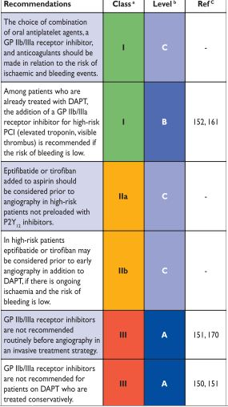
GP IIb?/IIIa inhibitors Summary
In trials of patients treated with medical therapy
abciximab did not improve outcomes
tirofiban was of benefit in patients in troponin positive patients
eptifibatide improved outcomes
In trials of intervention with balloon angioplasty ?PCI
outcomes were better with abciximab, tirofiban, or eptifibatide (compared to placebo)
Strong evidence for use in STEMI / PPCI

Slide 52
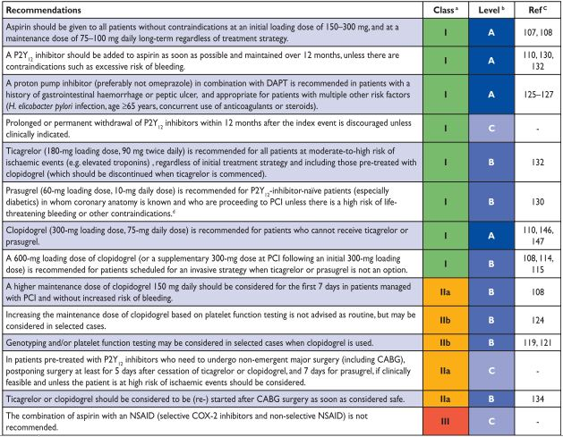
From evidence to Practice ESC Quidelines in ACS

Slide 53
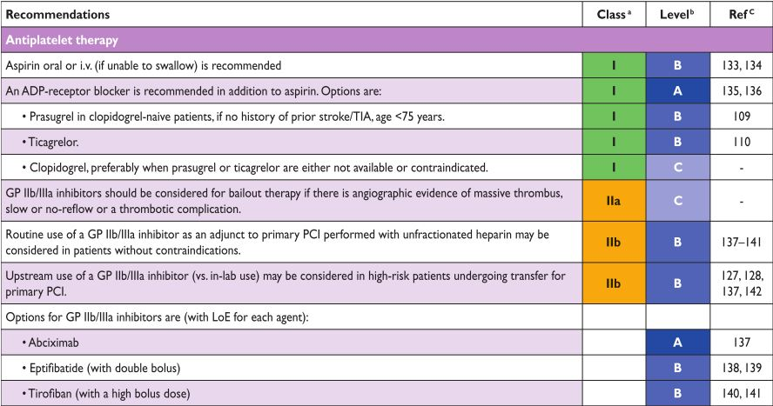
ESC Quidelines in STEMI

Slide 54
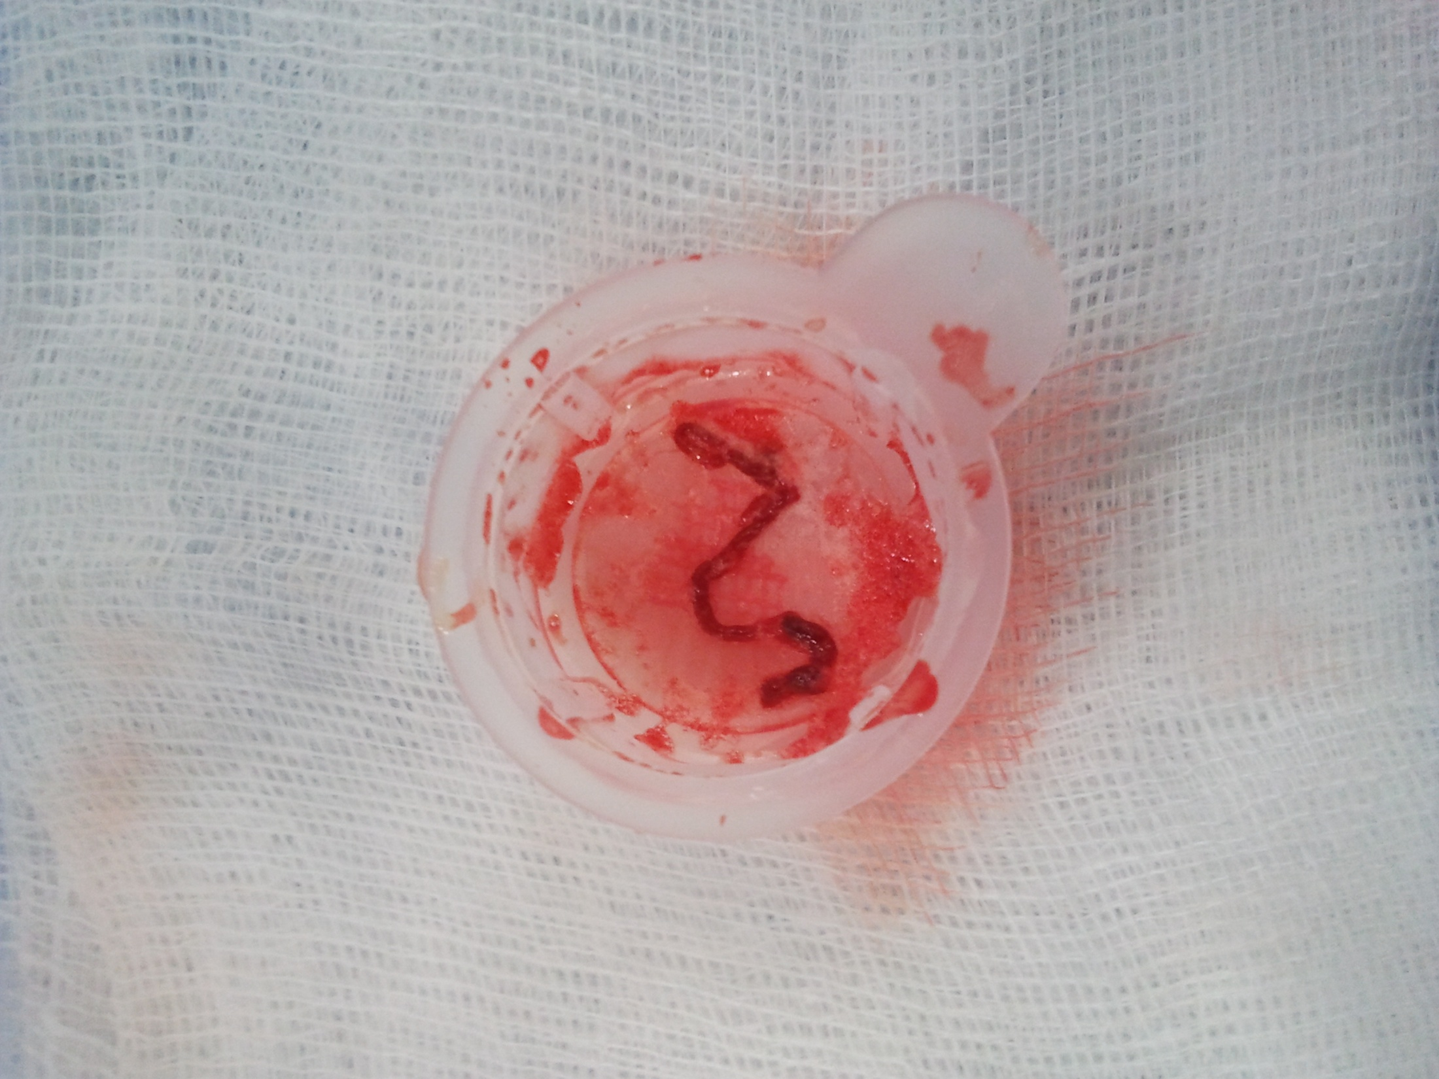
Ευχαριστώ

