Slide 1
Heart Disease
Dr Stasinos Theodorou
Consultant Interventional Cardiologist
Limassol Cardiology Practise
81 Agias Fylaxeos Street Limassol
www.cardiolimassol.com

Slide 2
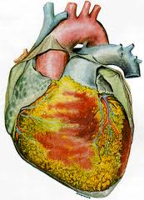
Valve disease
Heart muscle problems
(cardiomyopathy)
Coronary artery disease
Electrical disturbances (Arrhythmia)

Slide 3
Coronary artery disease
The leading cause of death in western societies
USA: 600,000 deaths per year
UK: 191,000 deaths per year
Europe: 2,000,000 per year
Significant national variation depending on lifestyle

Slide 4
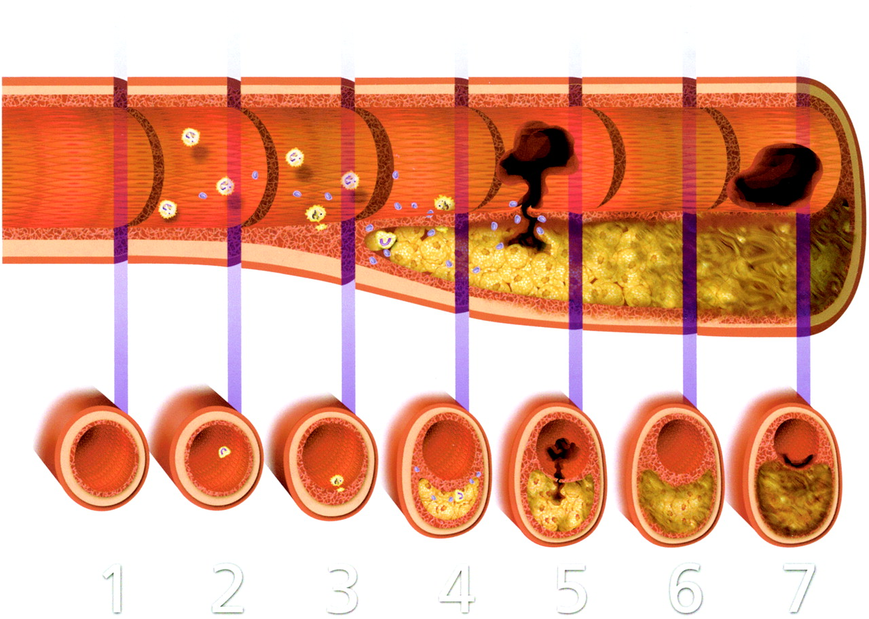
Atherosclerotic plague progression

Slide 5
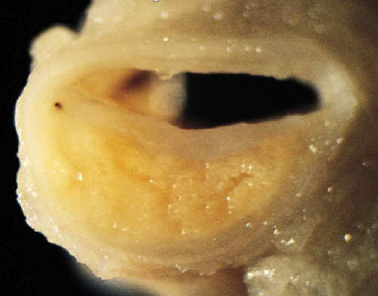

Slide 6
Risk factors
Increased cholesterol levels
High blood pressure
Diabetes- high sugar levels
Obesity
Smoking
Family history of coronary artery disease

Slide 7
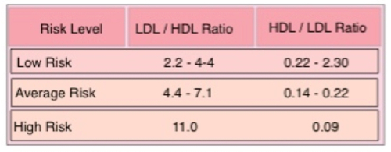
Cholesterol Profile
LDL: «Bad» cholesterol. Increased levels associated with increased risk.
HDL: «Good» cholesterol. Increased levels are protective.
Triglycerides. Increased risk

Slide 8
High cholesterol management
Low cholesterol diet
Eat healthy
Exersice regularly
Medications when indicated
Statins
Fibrates
Ezetimibe
Niacin
Nicotinic acid

Slide 9
Hypertension
PERSISTENT elevation
Diagnosis need monitoring
Serial measurments
Treatment is individualised
Several medications

Slide 10
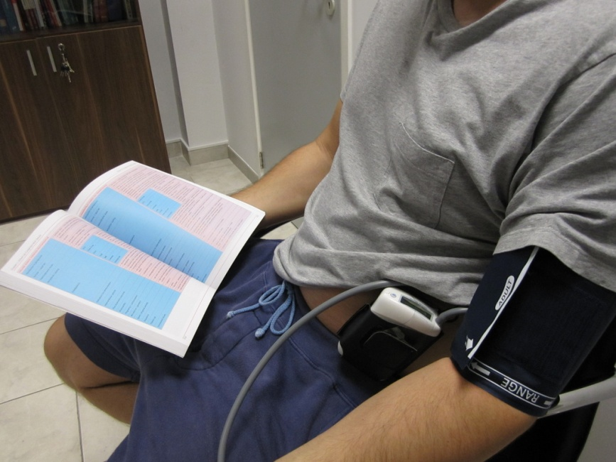
Hypertension diagnosis Ambulatory 24 hour blood pressure monitor

Slide 11
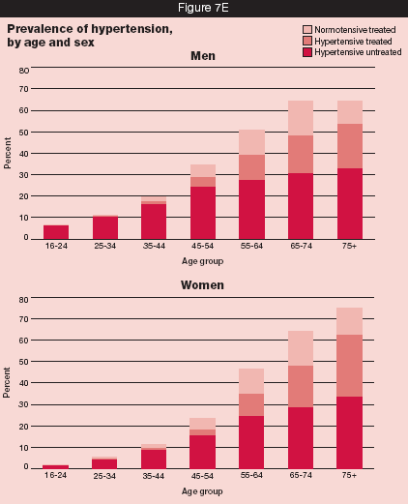
Hypertension prevalence

Slide 12
Hypertension grades

Slide 13
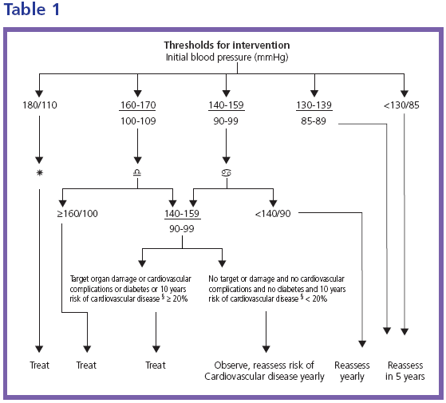
Hypertension treatment criteria

Slide 14
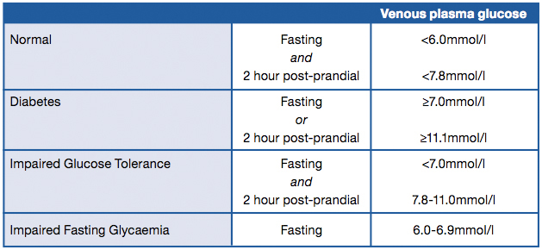
Diabetes
Elevated blood glucose levels
A result of diminished insulin production or...
Reduced sensitivity to it.
Classified primarily into Type 1 and Type 2

Slide 15
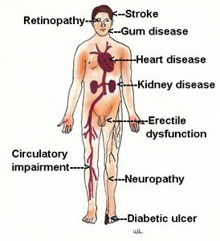
Diabetes effects

Slide 16
Diabetes treatment
Diet manipulation, low in carbohydrates
Exercise
Medications
Insulin injections
Regular eye checks
Feet review (chiropodists / podiatrists)
Kidney tests

Slide 17
Smoking
100,000,000 deaths in the 20th century
The single most important preventable risk to human health in developed countries
Second-hand smoke presents a very real health risk (600,000 deaths attributed in 2004)
Smoking is an independent major risk factor for CHD
Six-fold increase in Myocardial infarction in women
Three- fold increase in men.

Slide 18
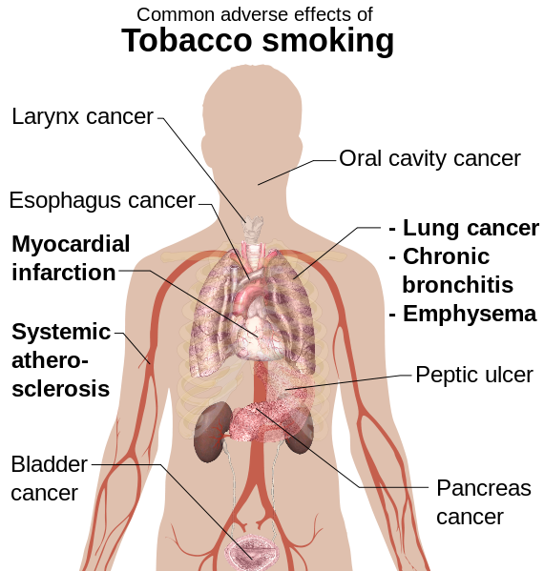
Smoking effects

Slide 19
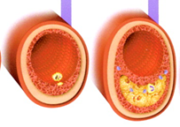
Coronary disease Manifestations
Can be asymptomatic (Silent)
In the stable stage symptoms present during exertion
Angina (central chest tightness/heavyness, neck, shoulders, arms)
Breathlessness
Occassionally palpitations, loss of consiousness

Slide 20
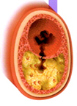
Coronary disease Manifestations
Acute coronary syndrome (Myocardial infarction)
Chest pain / angina at rest
Emergency requiring hospital care
May result in devestating complications
Specific treatment required

Slide 21
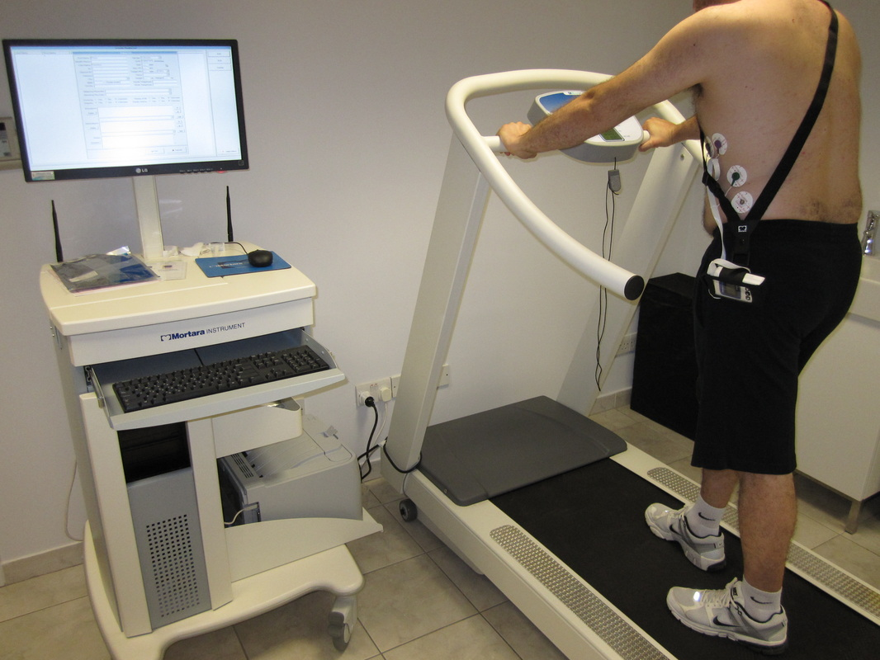
Coronary artery disease Diagnosis
Anatomical assessment
CT coronary angiography
Conventional / invasive coronary angiography
Functional assessment tools
Exercise stress testing
Myocardial perfusion imaging
Stress echocardiography
Stress MRI

Slide 22
Coronary disease Treatment
Lifestyle changes
Smoking cessation
Healthy diet
Risk factor control (Hypertension, diabetes, cholesterol)
Regular exercsie (As advised by cardiologist)
Medications:
Antiplatelet medications (Blood thinning)
Anti-cholesterol medication (statins)
Blood pressure medications
Anti-anginal medications (beta blockers, nitrates etc)
Mechanical revascularisation
Coronary angioplasty
Coronary artery by-pass grafting (open heart surgery)

Slide 23
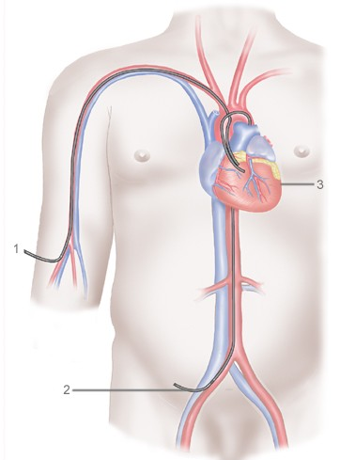
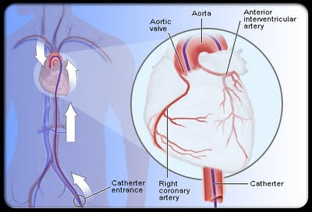
Coronary angiography and angioplasty

Slide 24
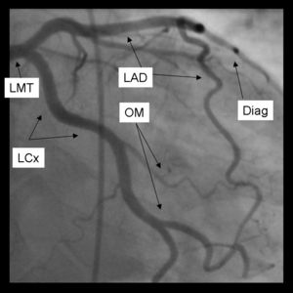
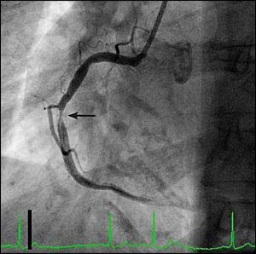
Coronary angiogram

Slide 25
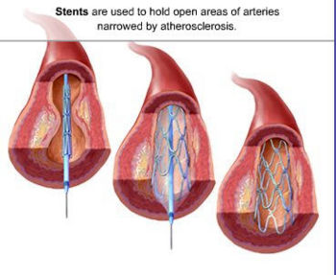
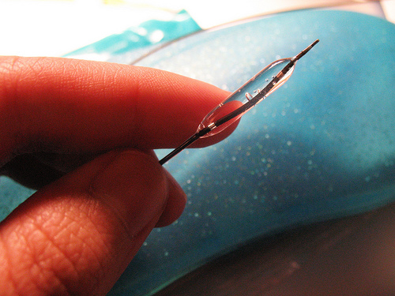
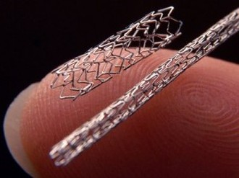

Slide 26
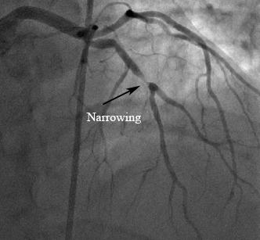
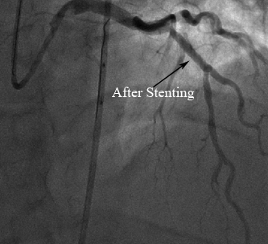

Slide 27
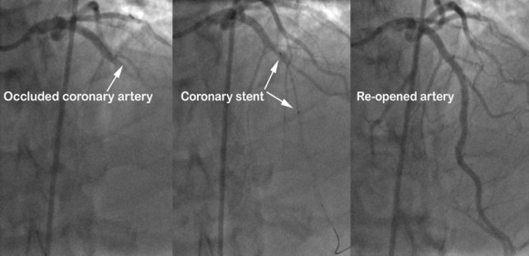

Slide 28
Thanks for your attention
WWW.CARDIOLIMASSOL.COM

